Slide 1
Osteoarthritis
Mustafa Al-Badran
CABM FIBMS
Internist and Rheumatologist

Slide 3
The most common form of arthritis
A major cause of pain and disability in older people

Slide 4
Osteoarthritis is characterised by
Focal loss of articular cartilage
Subchondral osteosclerosis
Osteophyte formation at the joint margin
Remodeling of joint contour with enlargement of affected joints

Slide 6
Epidemiology
The prevalence rises with age
All people develop O.A at some point during life
45% Knee OA
25% Hip OA
Ethnic differences
Knee OA higher in Africa, China, Japan and the Indian subcontinent
Hip O.A higher in European countries
Notes:
It has been speculated that the higher prevalence of knee OA in the Indian subcontinent and East Asia might be accounted for by squatting.

Slide 8
Pathophysiology
Complex disorder
Heritability
Polygenic
60% - 65% (Hip, Hand)
*Genetic component
*Environmental component
45% (Knee)
Notes:
Lower rates of OA have been observed in women who use hormone replacement therapy (HRT), and women who receive aromatase inhibitor therapy for breast cancer often experience a flare in symptoms of OA

Slide 9
Association
OBESITY (Mostly hip O.A)
Biomechanical factors
Cytokines released from adipose tissue*
OESTROGEN
STRUCTURAL ABNORMALITIES** such as slipped femoral epiphysis or Paget’s disease
OCCUPATIONS
Farmers (Hip OA)
Miners (Knee OA)
Professional athletes (Knee and Ankle OA)*
Notes:
*(Speculated)
**(abnormal load distribution across the joint)
There is also a high risk of OA in people who have had destabilizing injuries, such as cruciate ligament rupture, and those who have had meniscetomy.
Participation in recreational sport does not appear to increase the risk significantly

Slide 10
Slipped Capital Femoral Epiphysis
Notes:
Slipped Capital Femoral Epiphysis, is a common condition of the proximal femoral physis that leads to slippage of the metaphysis relative to the epiphysis, and is most commonly seen in adolescent obese males.
Diagnosis can be confirmed with radiographs of the hip.
Treatment is usually percutaneous pin fixation. Contralateral pinning is indicated for patients at high risk, such as those with an initial slip at age < 10, obese males, and those with endocrine disorders

Slide 11
Paget disease
Notes:
Paget disease is a localized disorder of bone remodeling that typically begins with excessive bone resorption followed by an increase in bone formation. [
This osteoclastic overactivity followed by compensatory osteoblastic activity leads to a structurally disorganized mosaic of bone (woven bone), which is mechanically weaker, larger, less compact, more vascular, and more susceptible to fracture than normal adult lamellar bon
Physical examination revealed a prominent saber-like tibia and superficial venous circulation related to chronic venous insufficiency (Panel A). Radiographs showed cortical thickening, trabecular enlargement, and bowing of the tibia (Panel B shows the anteroposterior view and Panel C the lateral view).

Slide 12
Miners
Farmers
Professional Athletes

Slide 13
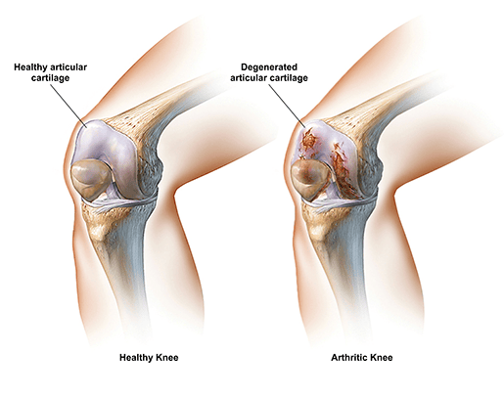
Degeneration of articular cartilage
Accelerated degradation of cartilage matrix (Reduced aggrecan and type II collagen) makes the cartilage vulnerable to load bearing injury
Fissuring of the cartilage surface (‘Fibrillation’)*,
Localized chondrocyte death
Pathology
Notes:
*(Defining Feature )
*leading to deep vertical clefts

Slide 14
Patients with OA have higher BMD values at sites distant from the joint*
Patients with OA are partially protected from developing osteoporosis and vice versa
Genetic factors
Predispose to osteoporosis
Protective form OA
Notes:
*(associated with osteophyte formation)

Slide 15
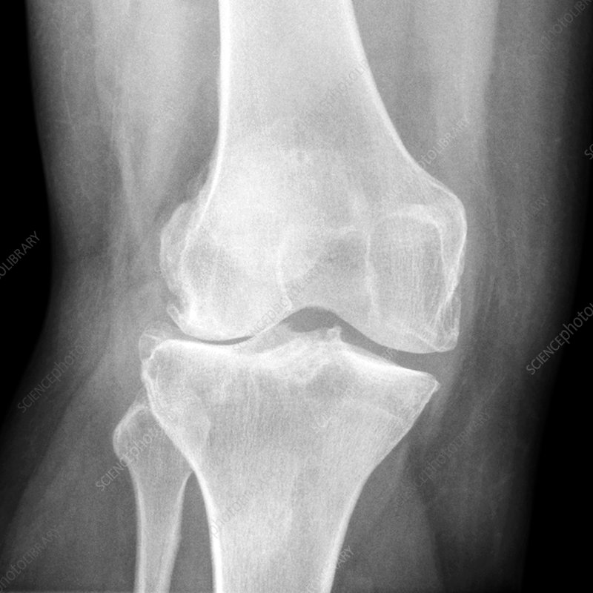
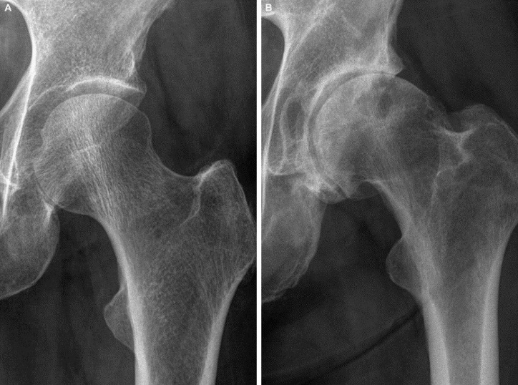

Slide 16
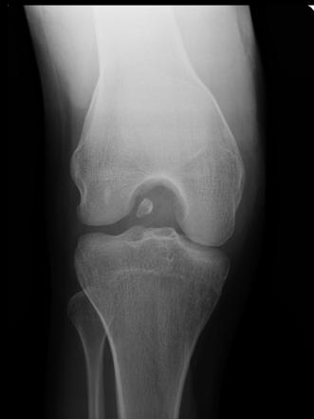
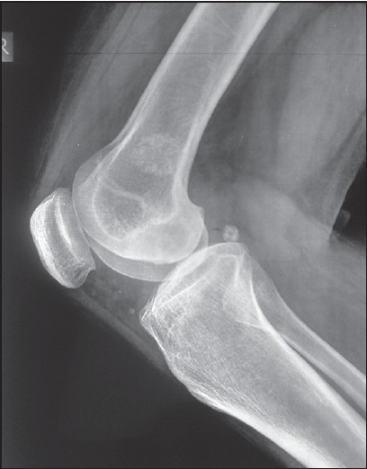
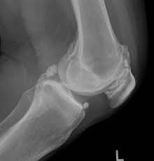
The synovium shows low grade inflammation
Chondroid metaplasia result in osteochondral bodies within the synovium
The outer capsule thickens and contracts
The muscles surrounding affected joints show evidence of wasting and non-specific type II fibre atrophy

Slide 17
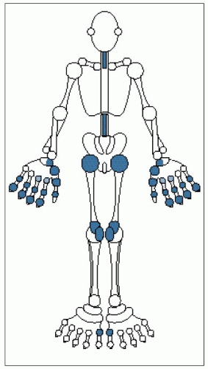
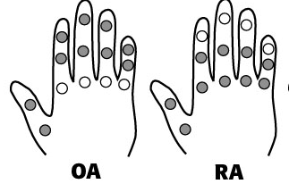
Clinical features
OA has a characteristic distribution, mainly targeting the hips, knees, PIP and DIP joints of the hands, neck and lumbar spine

Slide 18
The main presenting symptoms are
Pain
Functional restriction
Notes:
The causes of pain may relate to
Increased pressure in subchondral bone (Night pain)
Trabecular microfractures
Capsular distension
Low-grade synovitis
Bursitis
Enthesopathy

Slide 19
Symptoms and signs of Osteoarthritis
O.A Pain
Insidious onset over months or years
Intermittent (‘good days, bad days’)
Related to movement and weight-bearing, relieved by rest
Only brief (< 15 mins) morning stiffness and brief (< 5 mins)‘gelling’ after rest
Only one or a few joints painful

Slide 20
Clinical Signs
Muscle weakness and wasting
Bony swelling around joint margins
Deformity (Without instability)
Joint-line or periarticular tenderness
Restricted movement due to
Capsular thickening
Blocking by osteophyte
Palpable, sometimes audible, coarse crepitus *
Notes:
*(Rough articular surfaces)

Slide 21
Correlation between
Radiographic changes
Symptoms
Varies according to site
Notes:
It is stronger at the hip than at the knee, and poor at most small joints.*
At the knee reduced quadriceps muscle strength and adverse psychosocial factors (anxiety, depression) correlate more strongly with pain and disability than the degree of O.A changes
This suggests that the risk factors for pain and disability may differ from those for structural change.

Slide 22
Knee OA
Initially target Patello-femoral, Medial Tibio-femoral compartments eventually spreads to affect the whole joint
Bilateral and symmetrical involvement
Unilateral OA (In men, trauma)

Slide 24
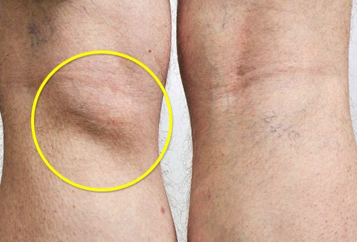
Anterior or medial knee and upper tibia pain
Patello-femoral pain is worse on inclines *
Posterior knee pain suggests the presence of a complicating popliteal cyst (Baker’s cyst)
Notes:
*going up and down stairs or
A Baker's cyst (also known as a popliteal cyst) is a fluid filled sac (cyst) behind the knee that causes tightness, pain, or knee stiffness that may worsen when you move your leg around or during physical activities.

Slide 25
Local examination findings may include
Antalgic gait*
Weakness and wasting of the quadriceps muscle
Joint-line and/or periarticular tenderness
Bony swelling around the joint line
Restricted Flexion and extension with coarse crepitus
A varus or, less commonly, valgus and/or a fixed flexion deformity
Notes:
A jerky, asymmetric gait with less time weight bearing on the painful side

Slide 28
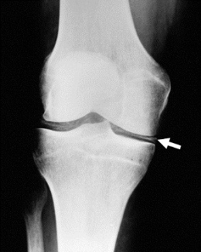
CPPD crystal deposition superimposed on Knee OA (‘pseudogout’) and associated with more rapid radiographic and clinical progression

Slide 29
Hip OA
Superior Hip OA (Common)
Unilateral at presentation
Progresses with super lateral migration of the femoral head
Poor prognosis
Central (Medial) OA (Less common )
Bilateral at presentation
Confined to women associated with nodal OA
Better prognosis
The hip shows the best correlation between symptoms and radiographic change

Slide 30
Examination may reveal • Antalgic gait • Weakness and wasting of quadriceps and gluteal muscles • Pain and restriction of internal rotation with the hip Flexed* • Anterior groin tenderness just lateral to the femoral pulse • Fixed Flexion, external rotation deformity of the hip • Ipsilateral leg shortening with severe joint attrition and superior femoral migration
Notes:
*( the earliest and most sensitive sign of hip OA)

Slide 31
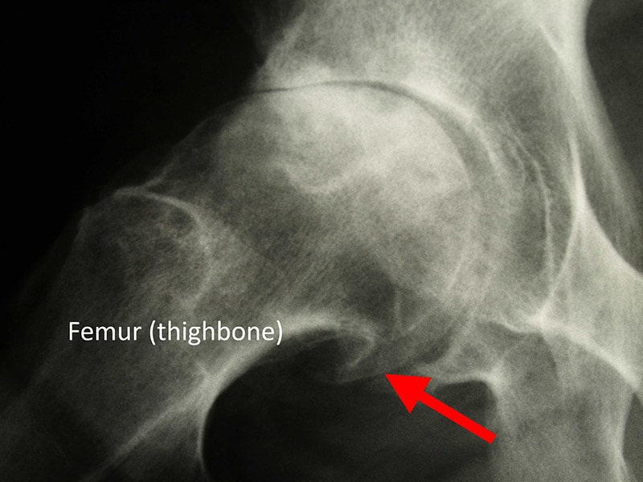

Slide 32
Spine OA
The cervical and lumbar spine are the sites most often targeted by OA
Cervical Spondylosis
Lumbar Spondylosis

Slide 33
Presentation
Pain localized to the neck or low back
Relieved by rest and worse on movement
Radiation of pain to the arms, buttocks and legs*
On physical examination
Limited range of movement
Loss of lumbar lordosis
Straight leg-raising test or femoral stretch test and neurological signs (Nerve root compression ,Spinal stenosis )

Slide 35
Early-onset OA (Before the age of 45 )
Monoarticular
Previous trauma
Pauciarticular or polyarticular
Juvenile idiopathic arthritis
Metabolic or endocrine disease
Haemochromatosis
Ochronosis
Acromegaly
Spondylo-epiphyseal dysplasia
Late avascular necrosis
Neuropathic joint
Notes:
Spondyloepiphyseal dysplasia congenita is a rare genetic disorder that involves spinal and epiphyseal enlargement . Classified as a type 2 collagen defect

Slide 36
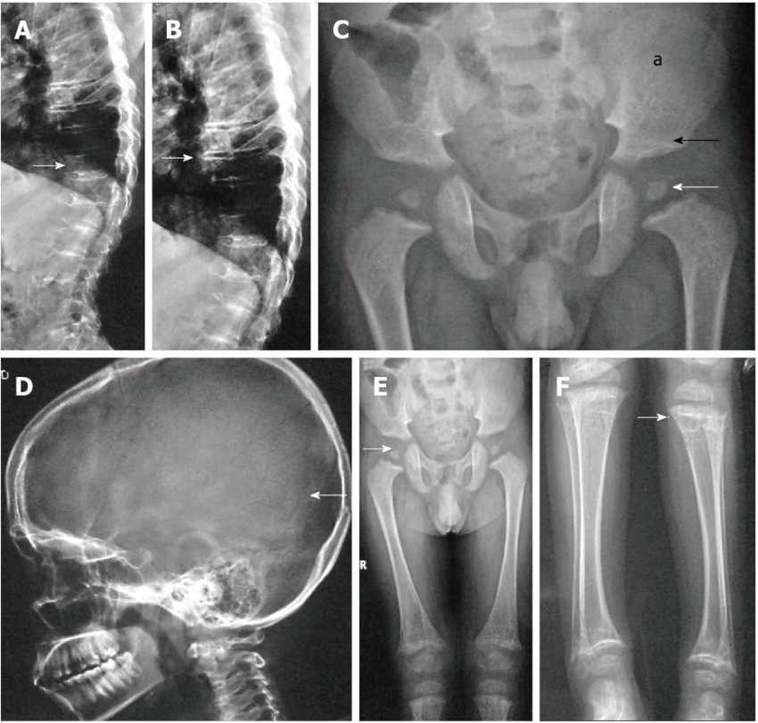
Spondylo-epiphyseal dysplasia
Notes:
Spondyloepiphyseal dysplasia congenita is a rare genetic disorder that involves spinal and epiphyseal enlargement Classified as a type 2 collagen defect, it affects a structure of connective tissue (collagen) that supports many parts of the body

Slide 37
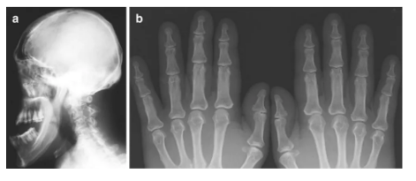
Haemochromatosis
Acromegaly
Notes:
Elongated mandible (a) and broad metacarpals and phalanges (b) characteristic of acromegaly

Slide 38
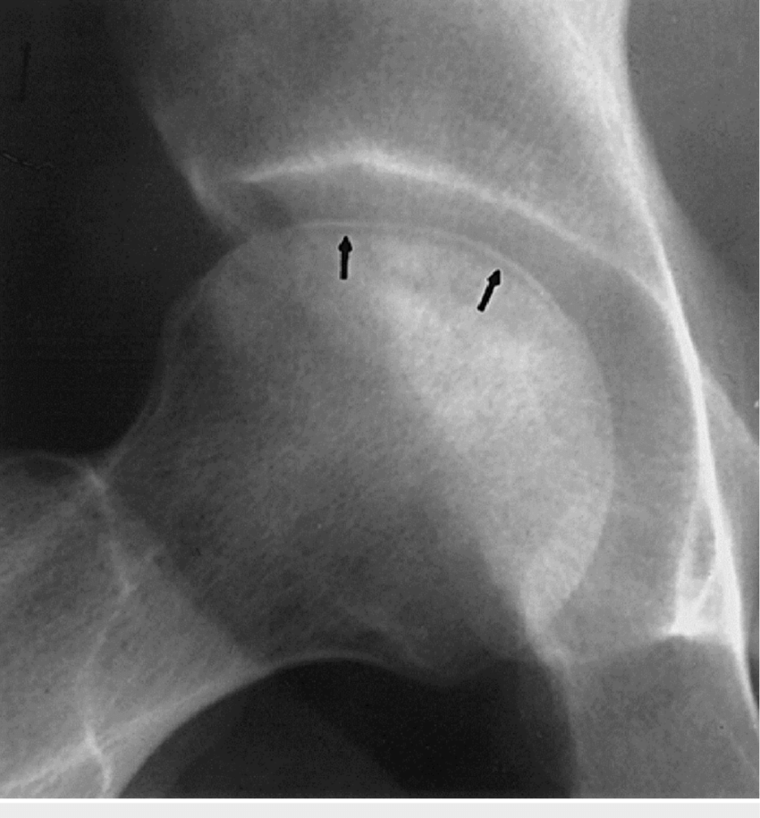
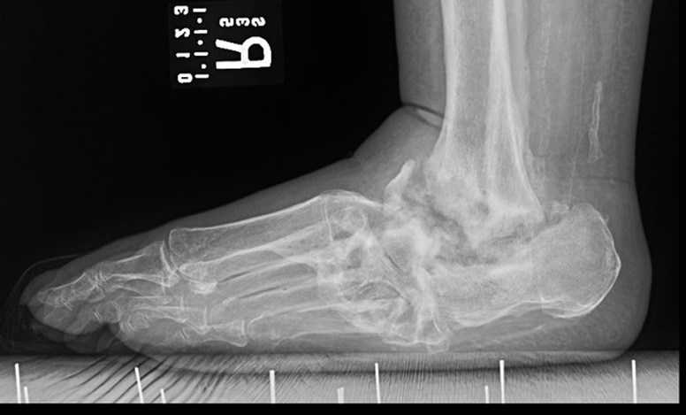
Neuropathic joint
Avascular necrosis

Slide 39
Ochronosis
Notes:
Alkaptonuria (AKU) is a rare inherited disorder of tyrosine metabolism, which leads to an accumulation of homogentisic acid (HGA) and is associated with a progressive arthropathy

Slide 40
Investigations
Plain X-ray of the affected joint
Diagnosis
Assessing the severity of structural change
Hip OA
Non-weight-bearing PA views of the pelvis
Knee OA
Standing AP X-ray→ Tibio-femoral
Flexed skyline view→ Patello-femoral
Spine OA
Lateral LSS X-ray
Routine biochemistry, haematology & autoantibody tests are normal with low synovial cell count

Slide 41
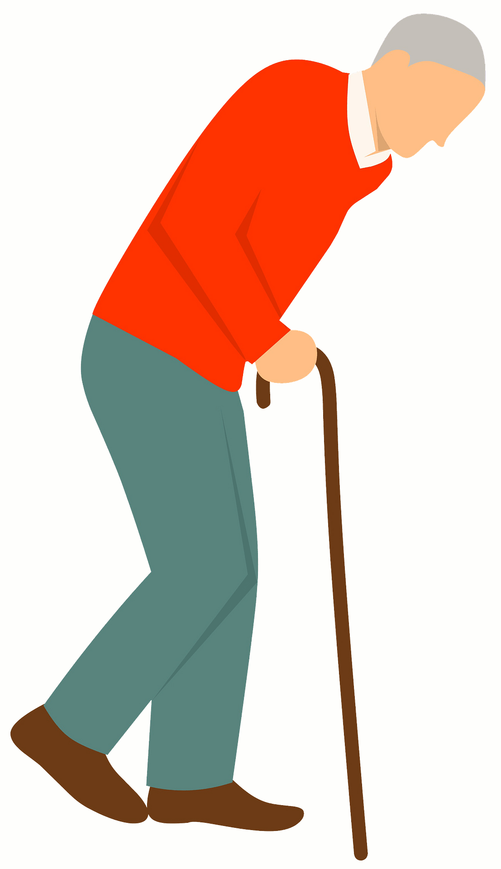
Management
Education
Lifestyle advice
Weight loss
Strengthening and aerobic exercises
Shock-absorbing footwear & built-up shoes
Pacing of activities
Use of a walking stick (knee or hip OA)
Notes:
*Equalize leg length

Slide 42
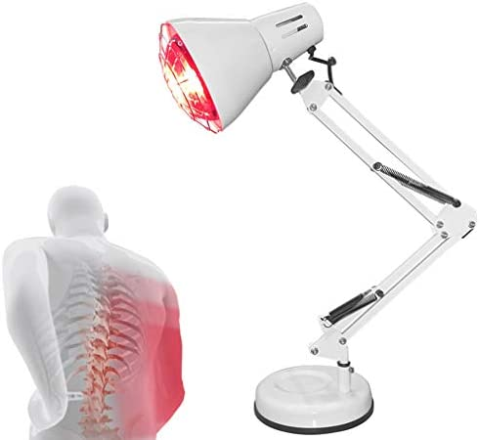
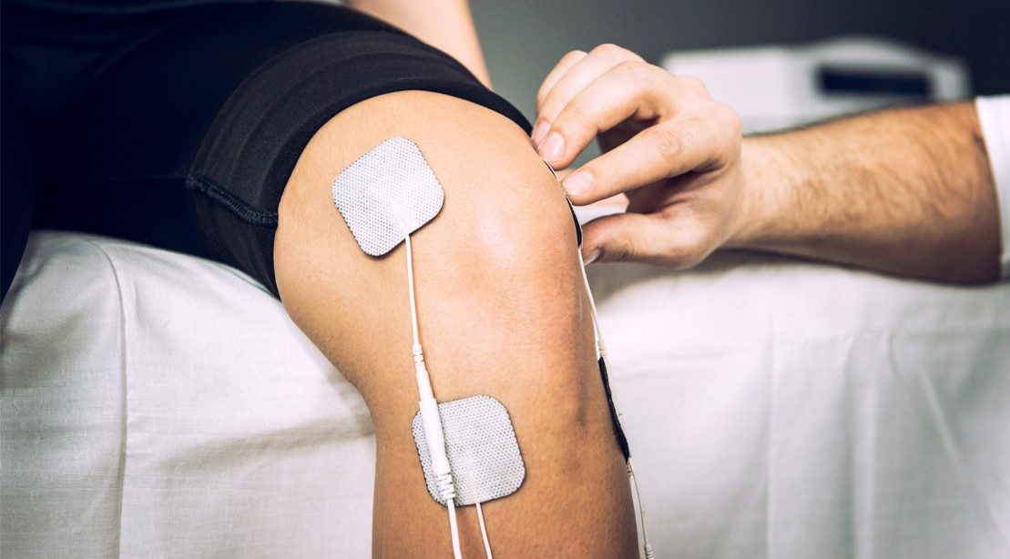
Non-pharmacological therapy
Acupuncture
Transcutaneous electrical nerve stimulation (TENS)*
Local Physical therapies, such as heat or cold**
Notes:
*Knee O.A
**temporary relief

Slide 43
Pharmacological therapy
Paracetamol
Topical NSAID
Oral NSAIDs
Strong Opiates
Amitriptyline, Gabapentin and Pregabalin

Slide 44
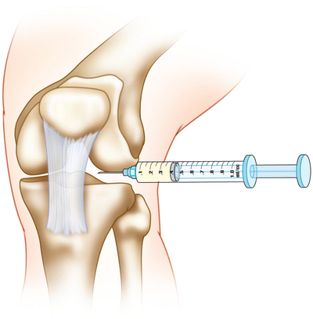
Intra-articular glucocorticoid injections
Effective in knee & 1st CMC joint OA
Short duration of effect (3 to 12 months )
Intra-articular injections of Hyaluronic acid
Expensive (Not cost-effective)
Short-lived effect

Slide 45
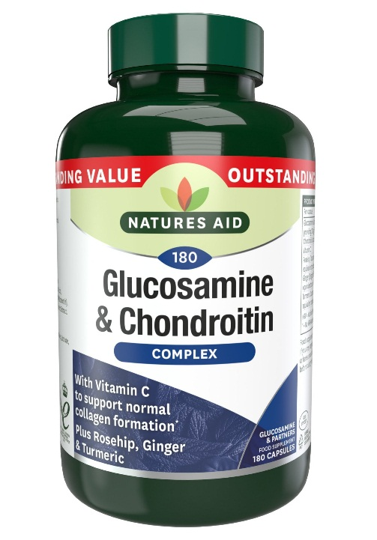
Neutraceuticals
Chondroitin sulphate &Glucosamine sulphate
Improve knee pain to a small extent (3–5%) compared with placebo in RCT

Slide 46
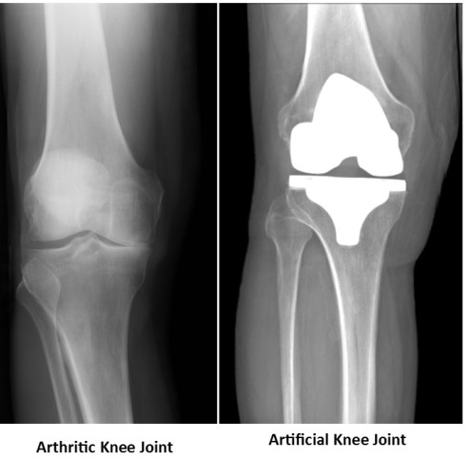
Surgery
Indicated in patients whose symptoms and functional impairment impact significantly on their quality of life despite optimal medical therapy and lifestyle advice and Total joint replacement surgery is the procedure of choice

